Slide 1
DIGITAL PORTFOLIO
𝗦𝗧𝗨𝗗𝗘𝗡𝗧 : HARINI K
𝗥𝗘𝗚𝗜𝗦𝗧𝗘𝗥 𝗡𝗢 𝗔𝗡𝗗 𝗡𝗠𝗜𝗗 : autunm1703212405431
𝗗𝗘𝗣𝗔𝗥𝗧𝗠𝗘𝗡𝗧 : 𝗕𝗖𝗔
𝗖𝗢𝗟𝗟𝗘𝗚𝗘 : 𝗔𝗞𝗦𝗛𝗘𝗬𝗔𝗔 𝗖𝗢𝗟𝗟𝗘𝗚𝗘 𝗢𝗙 𝗔𝗥𝗧𝗦 𝗔𝗡𝗗 𝗦𝗖𝗜𝗘𝗡𝗖𝗘,
𝗨𝗡𝗜𝗩𝗘𝗥𝗦𝗜𝗧𝗬 𝗢𝗙 𝗠𝗔𝗗𝗥𝗔𝗦.

Slide 2
🅟︎🅡︎🅞︎🅙︎🅔︎🅒︎🅣︎ 🅣︎🅘︎🅣︎🅛︎🅔︎
𝗜𝗡𝗧𝗘𝗥𝗔𝗖𝗧𝗜𝗩𝗘 𝗗𝗜𝗚𝗜𝗧𝗔𝗟 𝗣𝗢𝗥𝗧𝗙𝗢𝗟𝗜𝗢
𝗨𝗦𝗜𝗡𝗚 𝗛𝗧𝗠𝗟, 𝗖𝗦𝗦 & 𝗝𝗔𝗩𝗔𝗦𝗖𝗥𝗜𝗣𝗧

Slide 3
🅰︎🅶︎🅴︎🅽︎🆃︎🅰︎
Problem Statement
Project Overview
End users
Tools and Technologies
Portfolio design and layout
Features and Functionalities
Results and Screenshots
Conclusion
GitHub link

Slide 4
🄿🅁🄾🄱🄻🄴🄼 🅂🅃🄰🅃🄴🄼🄴🄽🅃
Static resumes do not provide an interactive experience for viewers and often fail to highlight technical skills India creative way. Using HTML, CSS and JavaScript, a student portfolio can be designed as a responsive and interactive web page that show cases personal details education skills soft skills and resume download. This approach solve the problem of Limited traditional resume by creating ya dynamic , user friendly , and accessible that reflects both technical and presentation skills.

Slide 5
℘𝘳ꪮ𝓳ꫀᥴ𝓽 ꪮꪜꫀ𝘳ꪜ𝓲ꫀ᭙
The project “ Interactive Digital Portfolio using HTML, CSS and Java Script “ web - based application design to showcase personal and academic information India structured interactive format.
The portfolio consists of the following coded components :
HTML – Provides the structure of the portfolio (header, navigation, about, education, skills, resume section).
CSS – Enhances the design with colours, layouts, rounded borders, and their responsive look using a purple theme.
JavaScript – adds interactivity, such as smooth scrolling when clicking on navigation links.
This portfolio highlight the student’s About Me, Education, Skills, Soft skills and Resume Download option in user friendly digital format. The project demonstrates how front – end technologies can be applied to create a professional, interactive portfolio website.

Slide 6
𝘞𝘩𝘰 𝘢𝘳𝘦 𝘵𝘩𝘦 𝘦𝘯𝘥 𝘶𝘴𝘦𝘳𝘴?
End Users
The interactive “Digital Portfolio” developed using HTML, CSS, and JavaScript is mainly intention for :
Students & Job Seekers – To present their education, skills, and achievements in a professional, interactive format instead of a static resume.
Recruiters & Employers – To easily view a candidate’s profile, skills, and resume download option in a structured and attractive web page.
Faculty / Academic Evaluators – To asseses the student’s technical knowledge, coding ability, and creative in building a digital portfolio.
Peers & General Audience – To view and get inspired by the portfolio design, content, and coding approach.

Slide 7
𝓣𝓸𝓸𝓵𝓼 𝓪𝓷𝓭 𝓽𝓮𝓬𝓱𝓲𝓺𝓾𝓮𝓼:
Tools Used
Techniques Applied in Code
Visual Studio Code ( VS Code)- Code editor for writing on testing HTML, CSS, and JavaScript.
Web Browser (Chrome/Edge/FireFox) - To run and test the portfolio website.
PowerPoint – For presenting the project details.
HTML – used for structuring sections like header,, navigation, about, education, skills, and resume.
CSS – applied for styling, adding back background colors ( purple theme ), rounded borders, Shadows, and layout adjustments.
JavaScript – implemented smooth scrolling effect for interactive navigation between sections.
Responsive Design – used flexible styling (like object- fit, border – radius, box- Shadow) to make the site user- friendly and visually appealing.

Slide 8
P̲o̲r̲t̲f̲o̲l̲i̲o̲ d̲e̲s̲i̲g̲n̲ a̲n̲d̲ l̲a̲y̲o̲u̲t̲
𝗗𝗲𝘀𝗶𝗴𝗻 𝗘𝗹𝗲𝗺𝗲𝗻𝘁𝘀 ( 𝗳𝗿𝗼𝗺 𝗖𝗦𝗦 𝗰𝗼𝗱𝗲 ) :
𝗟𝗮𝘆𝗼𝘂𝘁 ( 𝗳𝗿𝗼𝗺 𝗛𝗧𝗠𝗟 𝘀𝘁𝗿𝘂𝗰𝘁𝘂𝗿𝗲 ) :
Purple Theme : Backgrounds styled with background – colour : #8a1994 ( header ) and #fd73bf (body).
Rounded Corners & Shadows : border-radius and box-shadow used for sections to give a chard- like effect .
Typography : font-family : Arial, sans-serif for a clean and modern look.
Profile Section : Header contains name, role, and an optional profile picture with border-radius : 75%.
Header : Contains Name & Title (“Student”).
Navigation Bar : Links to sections ( About, Education, Skills, Soft Skills, Resume ).
Section Layouts : Each section (<section>) holds specific content inside. Section – content with padding and margins.
Resume Section : Include a Download CV option (<a
href =“resume. jpg”> Download CV </a>).
Footer : Displays copyright.
Smooth scrolling effect when clicking navigation links(window. scrollTo ({behaviour : ‘ smooth ‘})).

Slide 9
𝔽𝔼𝔸𝕋𝕌ℝ𝔼𝕊 𝔸ℕ𝔻 𝔽𝕌ℕℂ𝕋𝕀𝕆ℕ𝔸𝕃𝕀𝕋𝕀𝔼𝕊
Features (What it offers)
Functionalities (How it works)
Personalized Portfolio – Displays student details (About me, Education, Skills, Soft skills ).
Purple-Themed UI – Attractive and modern color scheme (#8a1994, #fd73bf).
Resume Download Option – Provides a link (<a href=“resume. jpg”>Download CV</a> to access the CV.
Responsive Sections – Each section is styled (. Section-content) with rounded corners and shadows for readability.
Navigation Bar – Easy access to different sections of the portfolio.
Smooth Scrolling – implemented in JavaScript for seamless navigation between sections.
Profile Picture option - circular design created with border-radius : 75% and object-fit : cover.
Interactive Links – Navigation links (<a href=“#section”>)scroll to respective sections dynamically.
Hover Effect on Buttons – Resume download button styled with hover (.section – content ) with rounded corners and shadows for readability.
Navigation Bar – easy access to different sections of the portfolio.

Slide 10
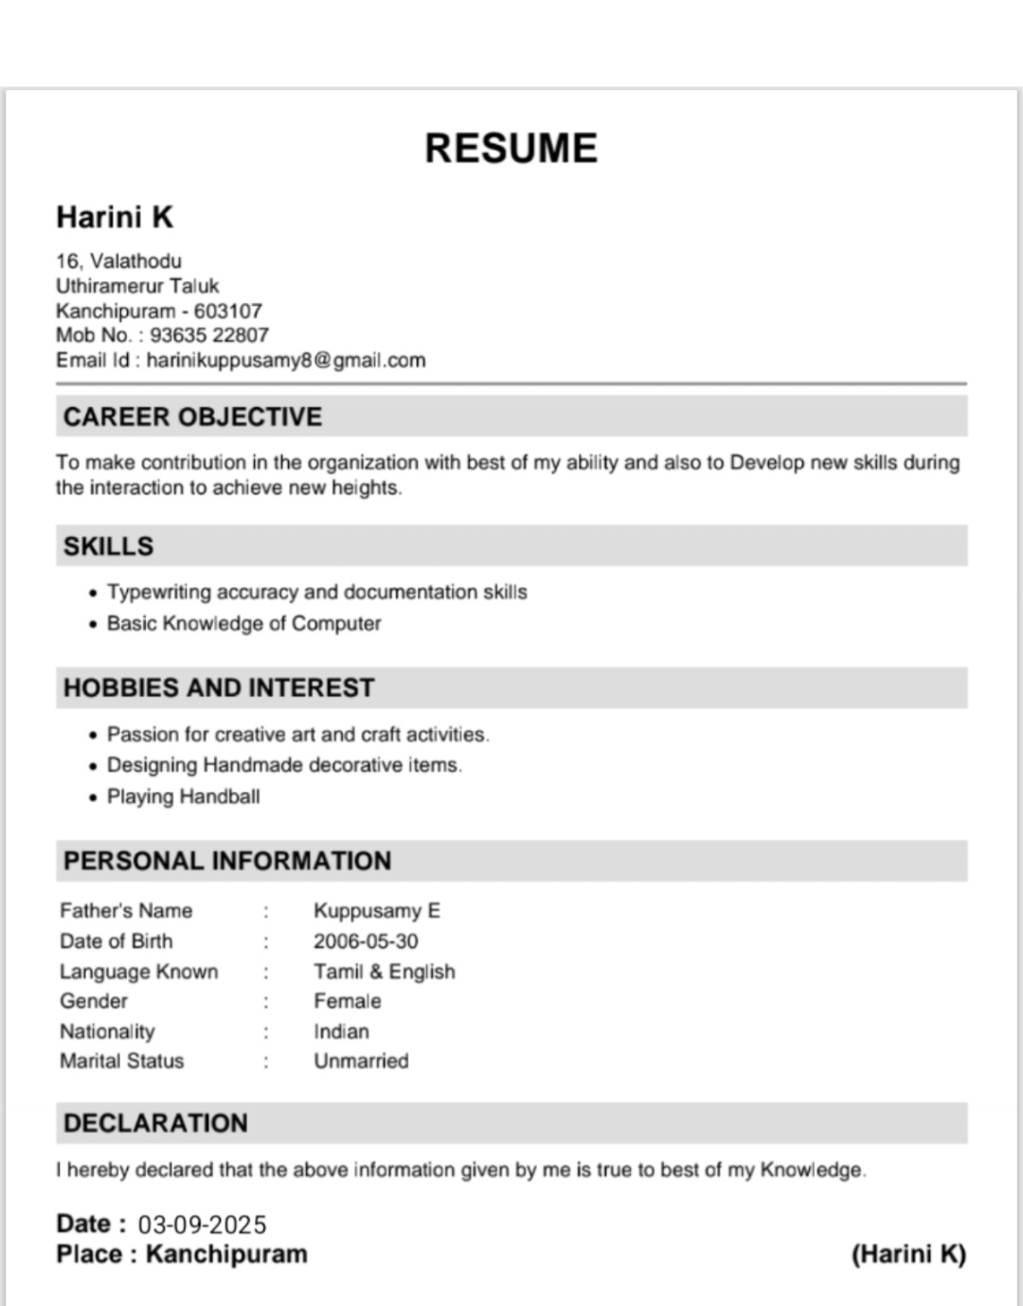
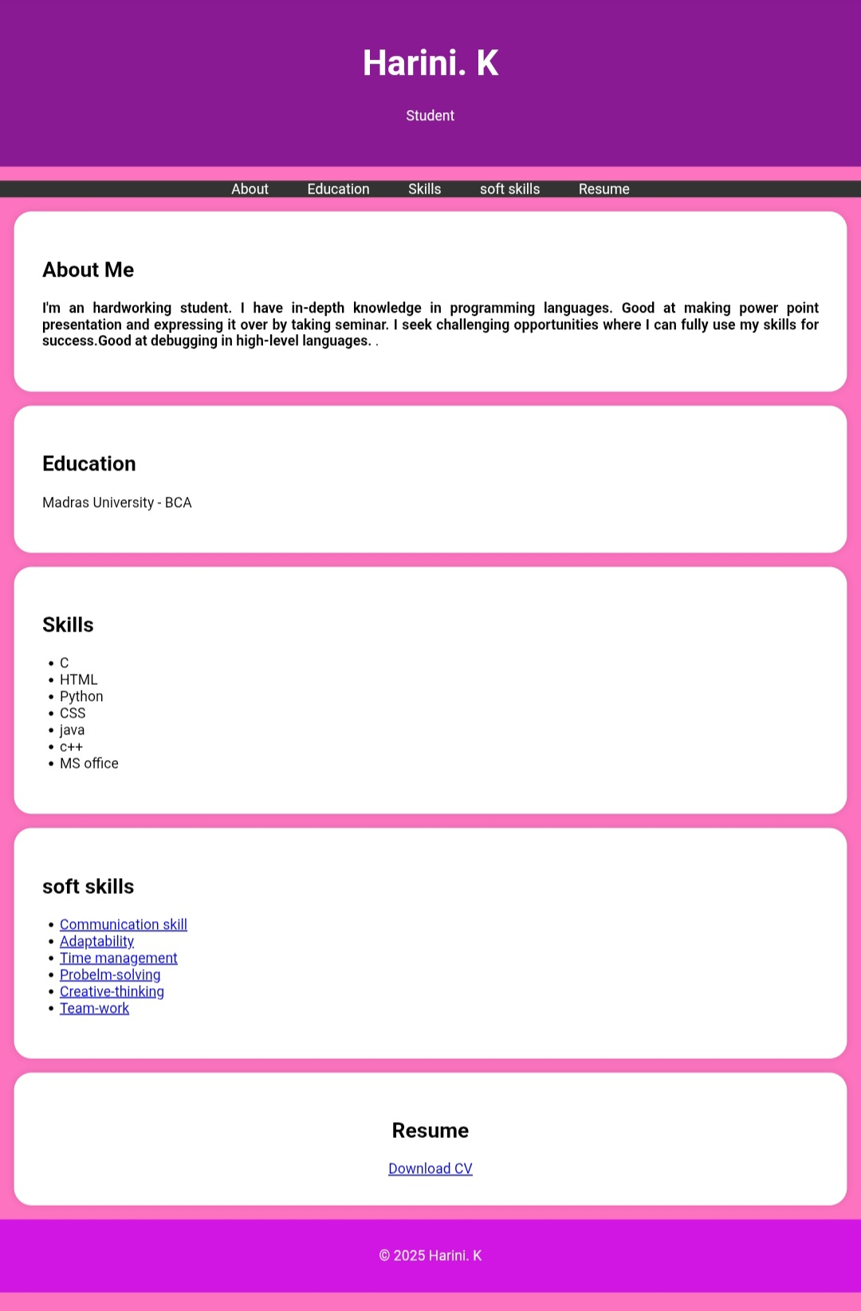
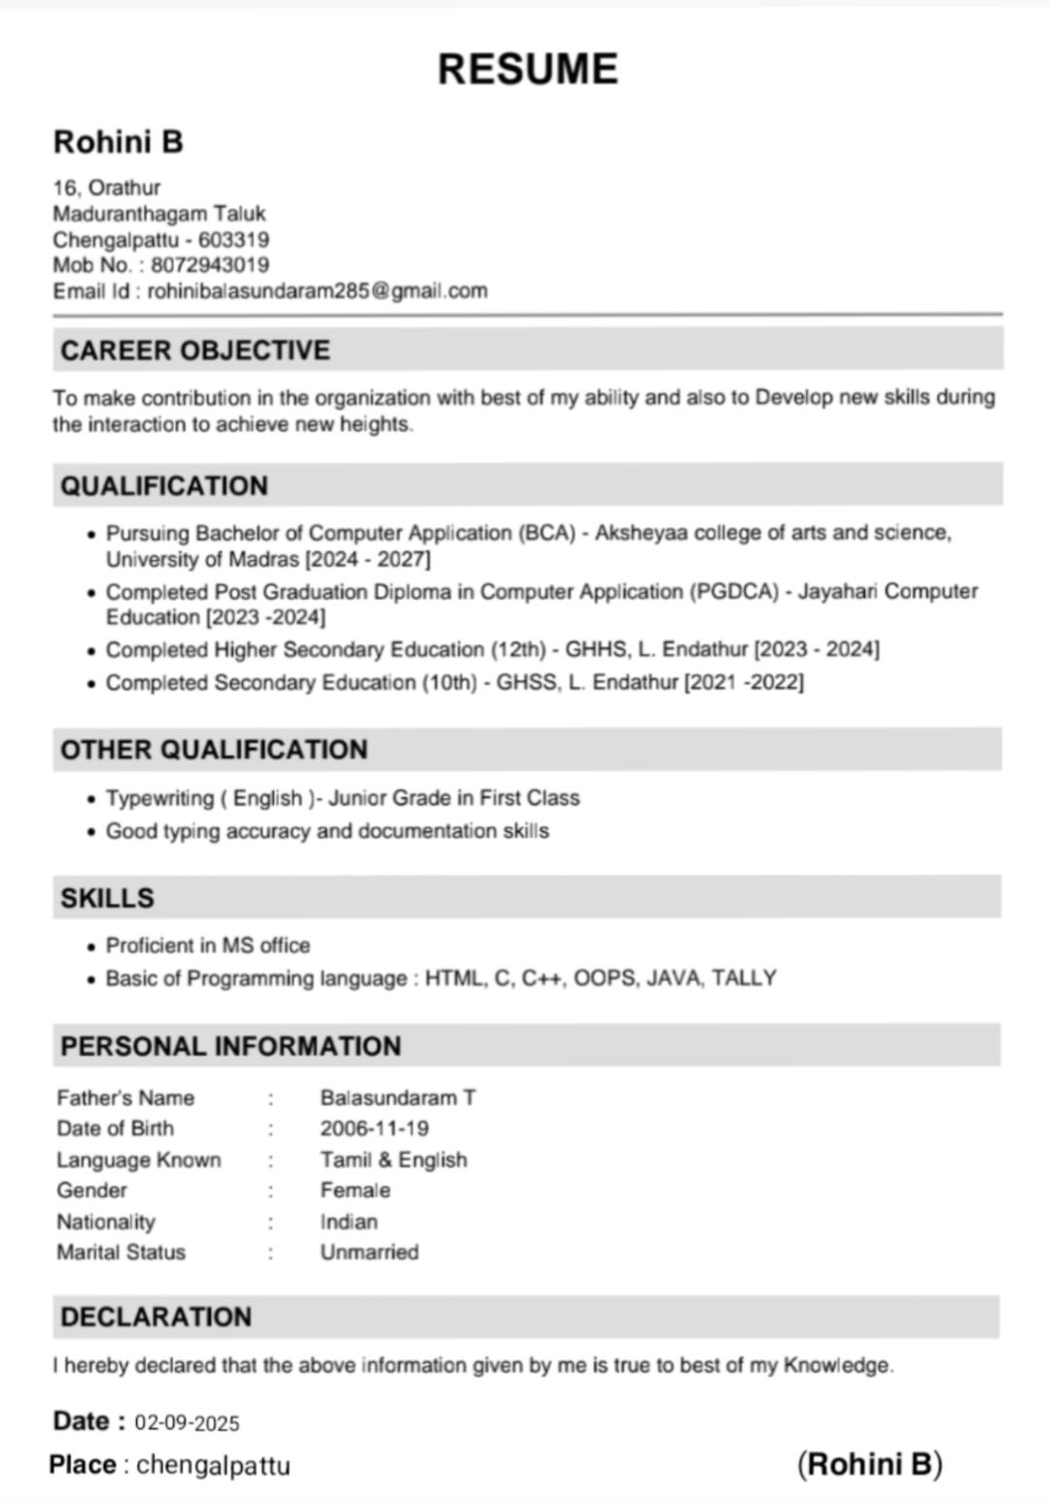
𝚁𝙴𝚂𝚄𝙻𝚃𝚂 𝙰𝙽𝙳 𝚂𝙲𝚁𝙴𝙴𝙽𝚂𝙷𝙾𝚃𝚂
Results
Screenshot
The portfolio displace personal details, education, skills, and resume download option.
the recent follows your purple theme with a clean, modern layout.
smooth scrolling and over effects that implemented to improve intractivity.
Thee final output is a user – friendly, responsive , and professional portfolio website that can be replace a static resume.

Slide 11
𝕮𝖔𝖓𝖈𝖑𝖚𝖘𝖎𝖔𝖓
The project “Interactive Digital Portfolio using HTML, CSS & JavaScript “ successfully demonstrates how front-end Web Technologies can be used to create a dynamic and professional portfolio.
it provides and interactive alternate to traditional resumes.
the portfolio effectively highlights personal details, education , and resume download option in a User-friendly manner.
the use of HTML for structure, CSS styling, and JavaScript for interactivity makes the project both technically sound and visually obtaining happily appealing.
This project show cases the student’s creativity, technical knowledge, and presentation skills, making it a valuable tool for academic and career opportunities.

